Slide 1
Huawei Intelligent Computing Product & Solutions
Date: March 2021

Slide 2
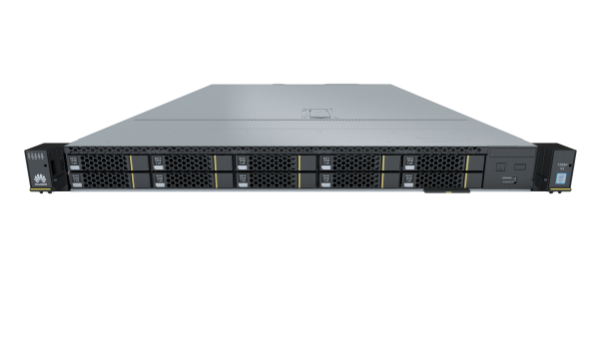
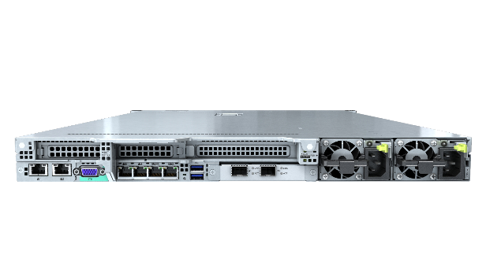
Huawei FusionServer 1288H V5: High-Density Deployment
Virtualization
Cloud computing
High-performance computing (HPC)
Web application
Software-defined storage (SDS)
AI inference
1RU 2S+24-DIMM Compact w/ medium Storage & I/O Options
For General Computing Applications w/o Need for very large local storage
High reliability
Ultimate performance
Unique value
Innovative design
Carrier-class component specifications and 100% derating design
Redundancy design: PSU modules in 1+1 mode, fan modules in N+1 mode, and memory module sparing/mirroring
99.99% availability
15% fewer failures than the industry average
2 x 2nd Gen Intel® Xeon® Scalable processors, up to 28 cores and TDP 205 W per CPU
24 DDR4 DIMMs, up to 2933 MT/s; a maximum of 12 Optane™ Persistent Memory (PMem), up to 2666 MT/s; total memory capacity up to 7.5 TB on a single server
No. 1 in SPECint®_base2006 and SPECfp®_base2006 performance tests
No. 1 in SPECpower ssj2008 Benchmark energy efficiency test
FDM: The patented Fault Diagnosis & Management (FDM) technology provides the fault locating accuracy up to 93% and predicts a fault 7 to 30 days before it occurs, reducing OPEX
DEMT: The patented Dynamic Energy Management Technology (DEMT) reduces energy consumption by 15% without compromising services
BSST: Boot Speedup Storage Technology (BSST), 2 M.2 SSDs as high-speed OS boot drives, industry-unique hot plug and hardware RAID
2 x 10GE and 2 x GE LOM ports, reducing CAPEX
Flexible NICs for higher networking capabilities
10 x 2.5'' SSAS/SATA HDDs or SSDs, providing ultra-large storage capacity
8 NVMe SSDs for optimal service experience
2 NVIDIA Tesla T4 GPUs for AI inference

Slide 3
Huawei 1288H V5: Multiple New SPEC Performance Records
SPECint_base2006 Test Result
SPECfp®_base2006 Test Result
Data released on http://www.spec.org/ as of Apr 2018

Slide 4
Huawei 1288H V5: New SPEC Energy Efficiency Records
SPECpower-ssj2008 Test Result
Data released on http://www.spec.org/ as of Apr 2019

Slide 5
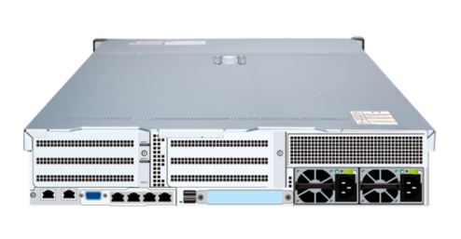
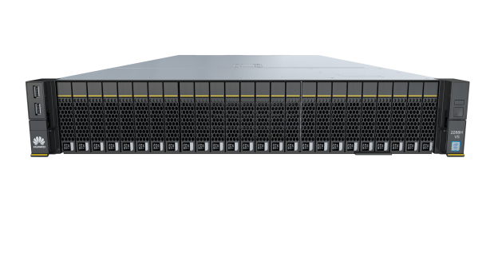
2288H V5:Flexible Configurations Adaptive to Various Workloads
Virtualization and cloud computing
Virtual desktop interface (VDI)
SDS
HPC
Big data and hyper-convergence
Entry-level in-memory database (SAP HANA)
AI inference or training
2RU 2S+24-DIMM Ultimate Performance w/ very flexible Storage & I/O Options
Many Storage Configurations Available
For General Computing Applications Requiring Balanced Compute & Storage
High reliability
Ultimate performance
Unique value
Innovative design
Carrier-class component specifications and 100% derating design
Redundancy design: PSU modules in 1+1 mode, fan modules in N+1 mode, and memory module sparing/mirroring
99.99% availability
15% fewer failures than the industry average
2 x 2nd Gen Intel® Xeon® Scalable processors, up to 28 cores and TDP 205 W per CPU
24 DDR4 DIMMs, up to 2933 MT/s; a maximum of 12 Optane™ Persistent Memory (PMem), up to 2666 MT/s; total memory capacity up to 7.5 TB on a single server
No. 1 in SPECint®_base2006 performance test
No. 1 in SPECpower ssj2008 Benchmark energy efficiency test
FDM: The patented Fault Diagnosis & Management (FDM) technology provides the fault locating accuracy up to 93% and predicts a fault 7 to 30 days before it occurs, reducing OPEX
DEMT: The patented Dynamic Energy Management Technology (DEMT) reduces energy consumption by 15% without compromising services
BSST: Boot Speedup Storage Technology (BSST), 2 M.2 SSDs as high-speed OS boot drives, industry-unique hot plug and hardware RAID
2 x 10GE and 2 x GE LOM ports, reducing CAPEX
Flexible NICs for higher networking capabilities
20 x 3.5'' or 31 x 2.5'' drives for industry-leading storage capability
28 NVMe SSDs for optimal service experience
7 Atlas 300 inference cards/NVIDIA Tesla T4 GPUs for AI inference
2 NVIDIA Tesla V100 cards for AI training

Slide 6
Huawei 2288H V5: New SPEC Energy Efficiency & Perf Records
SPECpower-ssj2008 Test Result
SPECint®_base2006 Test Result
Data released on http://www.spec.org/ as of Apr 2018

Slide 7
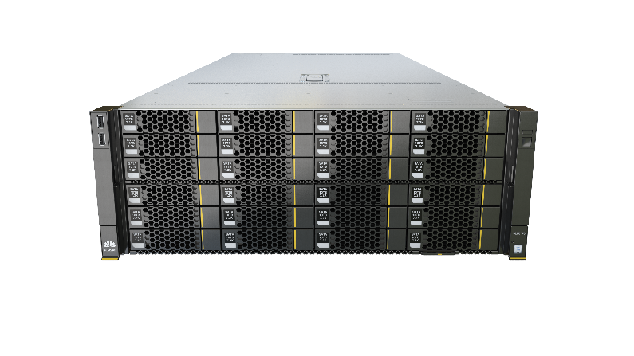
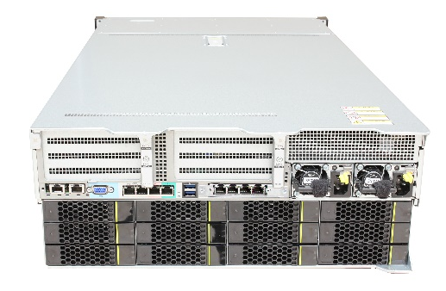
5288 V5: Ultra-Large Storage Capacity
Tiered storage of hot, warm, and cold data
Historical data archiving
Video surveillance, CDN, and big data
E-mail OA application
4RU 2S+24-DIMM High Performance w/ Ultra-Large Storage Capacity
Dual RAID controller cards for High IOPS
For Computing Applications Requiring Extreme Large Local Storage
High reliability
Ultra-large capacity design
Unique value
Innovative design
Carrier-class component specifications and 100% derating design
Redundancy design: PSU modules in 1+1 mode, fan modules in N+1 mode, and memory module sparing/mirroring
99.99% availability
15% fewer failures than the industry average
Hybrid storage architecture for tiered data storage
44 x 3.5'' SAS/SATA drives + 4 x 2.5'' SAS/SATA/NVMe SSDs in a 4U space, providing ultra-large local storage capacity
Industry-leading storage capacity, up to 765 TB on a single server
FDM: The patented Fault Diagnosis & Management (FDM) technology provides the fault locating accuracy up to 93% and predicts a fault 7 to 30 days before it occurs, reducing OPEX
DEMT: The patented Dynamic Energy Management Technology (DEMT) reduces energy consumption by 15% without compromising services
BSST: Boot Speedup Storage Technology (BSST), 2 M.2 SSDs as high-speed OS boot drives, industry-unique hot plug and hardware RAID
2 x 10GE LOM ports, reducing CAPEX
Flexible NICs for higher networking capabilities
6 Atlas 300 inference cards/NVIDIA Tesla T4 GPUs for AI inference, an industry-leading feature
Dual RAID controller cards, doubling IOPS

Slide 8
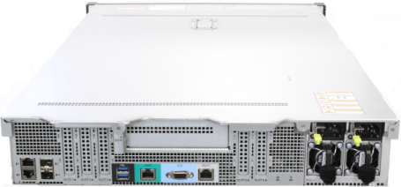
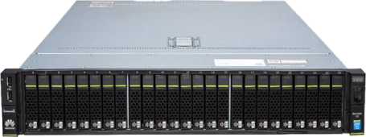
Huawei 2488 V5H: High Performance Computing
Virtualization
Cloud computing
HPC
Database
In-memory database (SAP HANA)
AI inference
4S+48-DIMM in 2RU for Ultimate Computing Performance w/ Large Memory
25x2.5” HDDs or NVMe SSDs for high performance storage
For Computing Applications Requiring 4-Socket & Large Memory in 2RU Space
High reliability
Ultimate performance
Unique value
Innovative design
Carrier-class component specifications and 100% derating design
Redundancy design: PSU modules in 1+1 mode, fan modules in N+1 mode, and memory module sparing/mirroring
65 RAS features
99.99% availability
15% fewer failures than the industry average
4 x 2nd Gen Intel® Xeon® Scalable processors, up to 28 cores and TDP 205 W per CPU
48 DDR4 DIMMs, up to 2933 MT/s; a maximum of 24 Optane™ Persistent Memory (PMem), up to 2666 MT/s; total memory capacity up to 15 TB on a single server
No.1 in SPECrate2017_int_base/SPECvirt_sc2013 benchmark/SAP B4H benchmark tests
Full mesh CPU architecture design, improving performance by 14.9%
FDM: The patented Fault Diagnosis & Management (FDM) technology provides the fault locating accuracy up to 93% and predicts a fault 7 to 30 days before it occurs, reducing OPEX
DEMT: The patented Dynamic Energy Management Technology (DEMT) reduces energy consumption by 15% without compromising services
BSST: Boot Speedup Storage Technology (BSST), 2 M.2 SSDs as high-speed OS boot drives, industry-unique hot plug and hardware RAID
2 x 10GE and 2 x GE LOM ports, reducing CAPEX
Flexible NICs for higher networking capabilities
25 x 2.5'' drives, providing the industry's largest storage capacity
3 NVIDIA Tesla T4 GPUs for image and video inference and analytics
Up to 11 PCIe 3.0 slots, the most in the industry for diverse applications

Slide 9
Huawei 2488H V5: New SPEC/SAP HAHA Performance Records
SPECrate2017_int_base Test Result
SPECvirt_sc2013 Test Result
SAP B4H Benchmark Test Result
Data released on http://www.spec.org/ as of Apr 2018

Slide 10
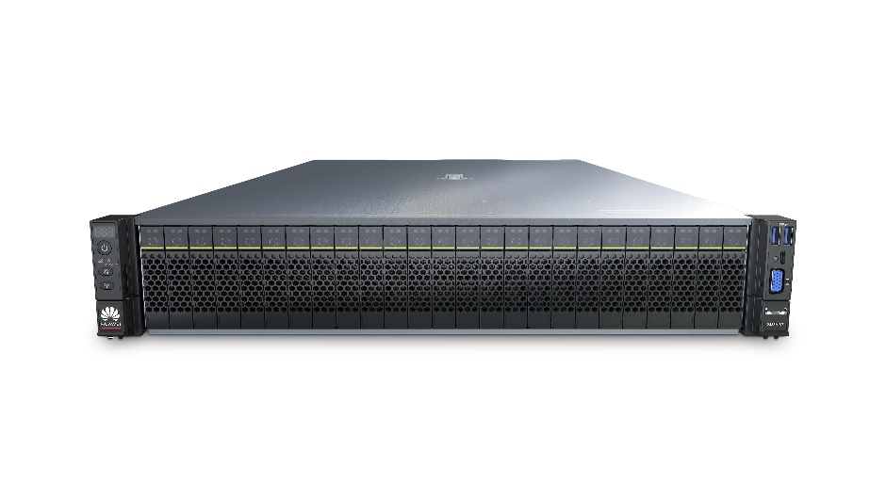
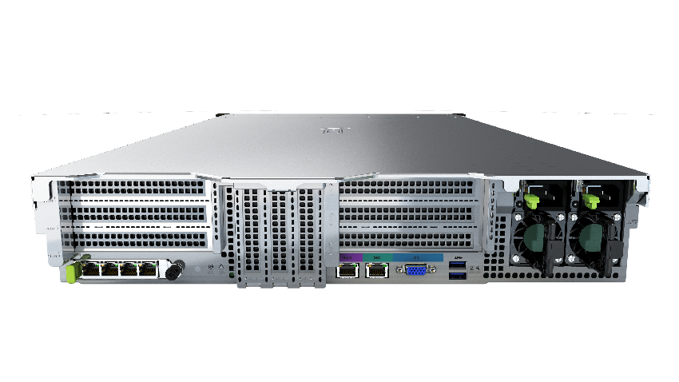
2488H V6: Stable and Reliable Mission Critical Server
Virtualization
Cloud computing
High-performance computing (HPC)
Database
In-memory database (SAP HANA)
AI inference and training
4S+48-DIMM in 2RU w/ Intel latest Xeon CPUs for Ultimate Computing Performance
25x2.5” HDDs or NVMe SSDs for high performance storage
For Computing Applications Requiring 4-Socket & Large Memory in 2RU Space
High reliability
Ultimate performance
Unique value
Innovative design
Carrier-class component specifications and 100% derating design
Redundancy design: PSUs in 1+1 mode, fan modules in N+1 mode, and memory module sparing/mirroring
69 RAS features
99.999% availability
15% fewer failures than the industry average
4 x 3rd Gen Intel® Xeon® Scalable processors, up to 28 cores and TDP 250 W per CPU
48 DDR4 DIMMs, up to 3,200 MT/s; 24 Intel® Optane™ persistent memory (Optane™ PMem) modules (200 series), up to 2,666 MT/s; total memory capacity of a single server up to 18 TB
2 x 300 W high-performance dual-width GPU accelerator cards, providing powerful computing for AI inference and training
FDM: The patented Fault Diagnosis & Management (FDM) technology provides the fault locating accuracy up to 93% and predicts a fault 7 to 30 days before it occurs, reducing the OPEX
DEMT: The patented Dynamic Energy Management Technology (DEMT) reduces energy consumption by 15% without compromising services
BSST: The Boot Speedup Storage Technology (BSST) uses 2 M.2 SSDs as high-speed OS boot drives, supporting the hardware RAID and the industry-unique hot plug for M.2 SSDs
2 FHFL dual-width GPU AI accelerator cards, such as Tesla V100
4 HHHL single-width GPU AI accelerator cards, such as Tesla T4
11 PCIe 3.0 slots, including one dedicated PCIe slot for the OCP 3.0 NIC (hot-swappable)
25 x 2.5'' SAS/SATA drives, up to 24 NVMe SSDs¹
Access to iBMC using Type-C, enabling agile O&M
¹ The configuration of 24 NVMe SSDs is estimated to be released in Q4 2020.

Slide 11
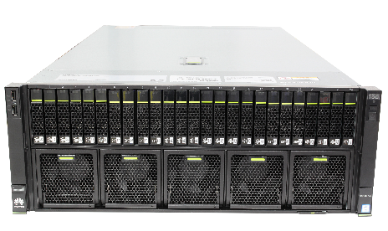
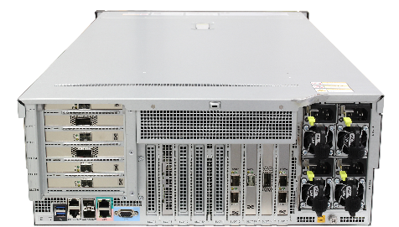
5885H V5: High Performance and Scalability
Virtualization
Cloud computing
HPC
Database
AI inference or training
4RU 4S+48-DIMM Scalable Ultimate Performance & Large Memory Capacity
15x PCIe Expansion slot for 4x T4 or 2x V100 Nvidia GPU cards for AI
For Computing Applications Requiring 4-Socket, Large memory & Scalability
High reliability
Ultimate performance
Unique value
Innovative design
Carrier-class component specifications and 100% derating design
Redundancy design: PSU modules in 1+1 mode, fan modules in N+1 mode, and memory module sparing/mirroring
Maintenance of front fan modules without opening the chassis cover
65 RAS features
99.99% availability
15% fewer failures than the industry average
4 x 2nd Gen Intel® Xeon® Scalable processors, up to 28 cores and TDP 205 W per CPU
48 DDR4 DIMMs, up to 2933 MT/s; a maximum of 24 Optane™ Persistent Memory (PMem), up to 2666 MT/s
Full mesh CPU architecture design, improving performance by 14.9%
FDM: The patented Fault Diagnosis & Management (FDM) technology provides the fault locating accuracy up to 93% and predicts a fault 7 to 30 days before it occurs, reducing OPEX
DEMT: The patented Dynamic Energy Management Technology (DEMT) reduces energy consumption by 15% without compromising services
BSST: Boot Speedup Storage Technology (BSST), 2 M.2 SSDs as high-speed OS boot drives, industry-unique hot plug and hardware RAID
2 x 10GE and 2 x GE LOM ports, reducing CAPEX
Flexible NICs for higher networking capabilities
4 NVIDIA Tesla T4 GPUs for image and video inference and analytics
2 NVIDIA Tesla V100 cards for AI training
Up to 15 PCIe 3.0 slots, the most in the industry for diverse applications

Slide 12
Some Use Cases

Slide 13
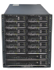
Huawei Servers Have Been Powering MTN Networks
Applications Powered By Huawei Servers
VAS Service: VAS Cloud, Voice mail
BSS & OSS: Billing, CRM, MV-OSS, CEM
Core Network: vEPC, vMSE, vIMS, vSBC
ITSS: Email, DNS cache, DMS, VDI, REMEDY, Load Runner, DMS, Reporting, Domain Controller, Audit Tracker, File Server
Uganda
Rwanda
Ghana
Zambia
Nigeria
Swaziland
Congo
South Africa

Slide 14


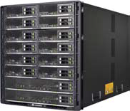
Huawei Servers: Honored On Orange Procurement Short-List
Why Huawei?
High Performance, Reliability, Scalability & Quality
Second Source to Break Monopoly
To Lower TCO
Huawei Servers Honored on the Short-List
FusionServer Pro 1288 V5, 2288 V5 for IT & B2B
E9000 V5 for NFV
Orange Group (French: Orange SA, Orange), formerly known as France Télécom SA, is France's leading telecommunications company with more than 220,000 employees worldwide and approximately 90 million customers. (including the overseas provinces of France).
RH1288 V5
RH2288 V5
E9000 V5

Slide 15
Huawei Servers Have Been Powering Orange Networks
Tunisia
Blade E9000
Rack 1288/2288
France
- Blade E9000
Rack 2288/1288/5288
(+2020 delivery on going)
Poland
- Blade E9000
Egypt
- Blade E9000
Rack 2288/1288
Slovakia
- Blade E9000
Moldova
- Blade E9000
Mauritius
- Blade E9000
- Rack 2288/1288
Bissau
- Blade E9000
Ivory Coast
- Blade E9000
Rack 2288/1288
Spain
Blade E9000
Romania
Blade E9000
Rack 2288/1288
DRC
- Blade E9000
Madagascar
- Blade E9000

Slide 16
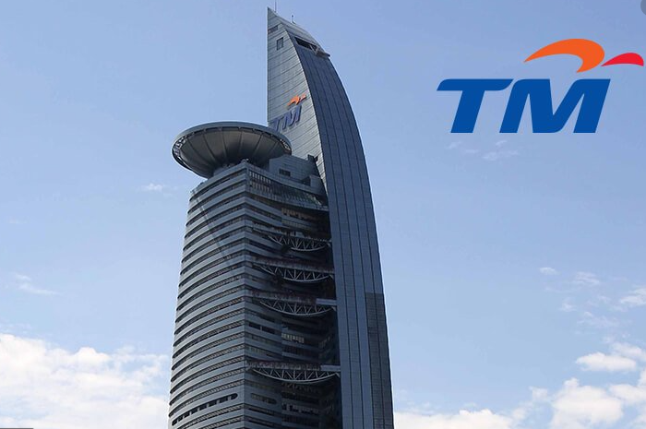
Huawei Servers Powering Telekom Malaysia NFV Services
Why Huawei?
Long-Term Partner & E2E NFV Solution Provider
Worked Closely with TM to Deliver Successful POC
High Performance, Reliability, Scalability & Quality
Easy O&M
Huawei Servers Deployed in 2019
FusionServer RH2288 V5 with Intel 1st Xeon SP Processors
Huawei Cloud Stack (HCS) Software
Founded in 1984, Telekom Malaysia (TM) is the largest fixed network provider in Malaysia. It provides customers with fixed network, data access, Internet services, and value-added service solutions based on fixed networks.
RH2288 V5

Slide 17

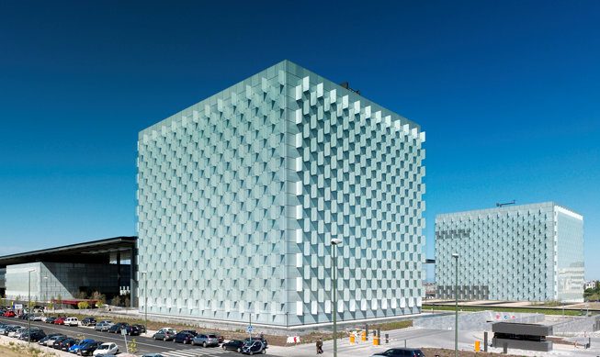
Huawei Helping Telefonica Accelerate CDN Services
Why Huawei?
Long-Term CDN Partner for E2E Solution to Reduce TCO
High Performance, Reliability, Scalability & Quality
2288H V5 supports long-term stable running at 45°C with Cascade Lake processors (28 cores/processor) of full power consumption
Huawei Servers Deployed
FusionServer RH2288 V5 with Intel Xeon Cascade Processors
Telefonica is short for Telefónica of Spain. Founded on April 19, 1924, Telefónica is an international telecommunications company that provides comprehensive services, including fixed-line, mobile, Internet, data, and cable TV services. It has a significant presence in Spanish-speaking and Portuguese-speaking countries. In October 2019, Telefónica ranked No. 22 in the Forbes Digital 100 List.
RH2288 V5

Slide 18


Italian TIM Accelerates DIGITIM Strategy with Huawei Servers
Why Huawei?
High Performance, Reliability, Scalability & Quality
Working up to 45°C to Save Energy & Cost
eSight management system for unified management in the data center for O&M improvement & 10% Cost Saving
Huawei Servers Deployed
FusionServer Pro 1288 V5 w/ Intel Xeon Cascade Lake CPU
eSight Unified Data Center Device Management Software
Telecom Italia is the largest telecommunications operator in Italy, with operations in the fixed, mobile, media and Internet sectors. The Italian Telecom Group has inherited the electronic communication business that has been in development for more than 100 years, and is also involved in media, network and cutting-edge information technology. The Group is committed to the research and development of future technologies.
RH1288 V5

Slide 19


Huawei Servers: Honored on Vodafone Procurement Short-List
Why Huawei?
High Performance, Reliability, Scalability & Quality
Working up to 45°C to Save Energy & Cost
Second Source for Breaking Monopoly
Huawei Servers Deployed
FusionServer RH1288 V5 for general & Virtualization
FusionServer RH2288 V5 for Virtualization & Big-Data
FusionServer E9000 V5 for Converged Solutions for Critical Business Applications via Resource Pooling
Vodafone Group, the world's second largest mobile communications company, is a multinational mobile phone operator. Headquartered in Newbury, Berkshire, UK and Düsseldorf, Germany. It is one of the world's largest mobile operators, with a network covering 26 countries and providing network services with its partners in 31 other countries. Vodafone has the world's most complete enterprise information management system and customer service system, and has a strong advantage in increasing customers, providing services and creating value. Vodafone's global strategy is to cover voice, data, Internet access services and provide customer satisfaction. Vodafone Group has more than 100,000 employees worldwide
RH1288 V5
RH2288 V5
E9000 V5
2S & 4S Blades

Slide 20

Huawei Servers Help Vodafone Spain Build 5G Core Network
Why Huawei?
High Performance, Reliability, Scalability & Quality
Working up to 45°C to Save Energy & Cost
Second Source for Breaking Monopoly
Modular Blade Server greatly simplifies maintenance & allows for flexible expansion
Heterogeneous computing expansion saves investment
eSight Mgnt software enhances O&M with Unified Compute, Storage and Network Mgnt for Higher O&M efficiency
Huawei Servers Deployed
FusionServer Pro RH1288 V5
FusionServer E9000 V5 Blade
The Vodafone Group, the world's second largest mobile communications company, is a multinational mobile phone operator. Headquartered in Newbury, Berkshire, UK and Düsseldorf, Germany. It is one of the world's largest mobile operators, with a network covering 26 countries and providing network services with its partners in 31 other countries. Vodafone has the world's most complete enterprise information management system and customer service system, and has a strong advantage in increasing customers, providing services and creating value. Vodafone's global strategy is to cover voice, data, Internet access services and provide customer satisfaction. Vodafone Group has more than 100,000 employees worldwide
RH2288H V5
E9000 V5

Slide 21

Huawei Servers Power VEON Online Digital Services Development
Why Huawei?
High Performance, Reliability, Scalability & Quality
Working up to 45°C to Save Energy & Cost
FusionDirector for quick server installation & deployment & visualized O&M of massive devices, reducing the OPEX.
Huawei Servers Deployed
FusionServer Pro RH1288 V5 for general-purpose & Virtualization
FusionServer Pro 2288 V5H for VMware vSAN & Microsoft S2D SDS with large storage capacity
FusionServer Pro 2488H V5 & 5885H V5 for Mission-Critical Applications
Founded in 1992, VEON Ltd. is headquartered in Amsterdam, the Netherlands. With 41,994 full-time employees, VEON is the world's seventh largest telecom operator and the world's sixth largest mobile network operator. It provides a series of voice and data services, including traditional, mobile broadband, and fixed network services.
As a world-class network carrier, VEON has subnets in seven countries and strives to rank top 2 in the market of all subnets. The digital transformation goal is to transform from a network carrier to an Internet service provider. Since the end of 2017, VEON APP has gone online on all 12 networks and become the B2B/2C platform. VEON also develops APP partners and the big data analytics platform DMP.
RH1288 V5
RH2288 V5
RH2488H V5
RH5885H V5

Slide 22
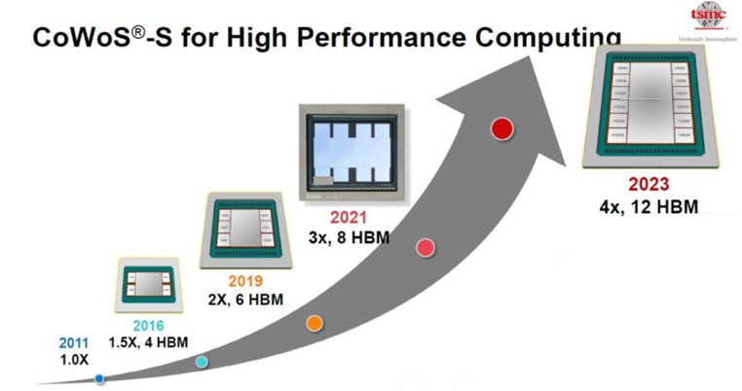
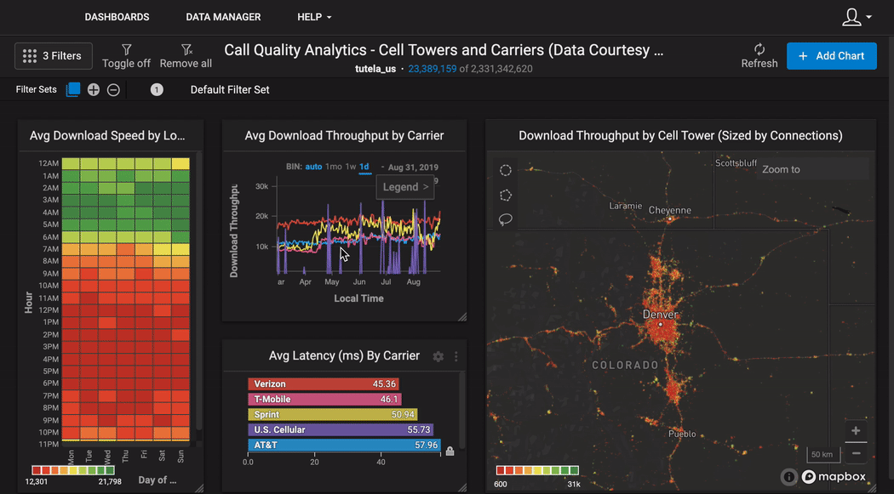
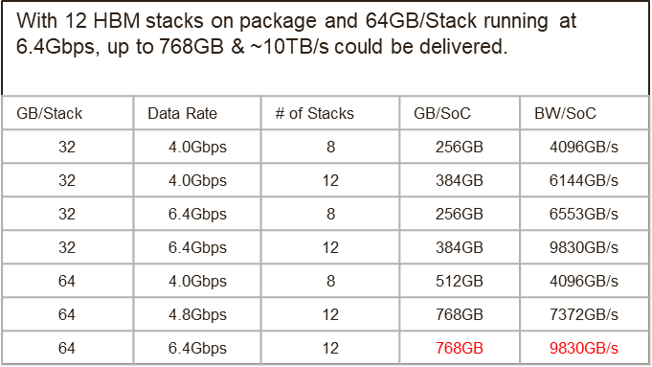
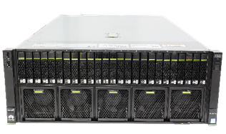
HBM is Enabling Interactive Analysis on Massive Datasets
HBM is becoming CPU main memory for HPC, AI & HPDA, enabling Interactive Analysis on Massive Datasets
For 768GB & 10TB/s & 64B Logs, max 300B-Record-Scans/s & 24B Records per CPU w/ 2x Compression in 3-5 Years
OmniSCI is delivering an Amazing Interactive Analysis Platform for massive log datasets with Location-time information on HBM (GPU)
~$120/GB in 2016
~$7,5/GB in 2020
Image source & credit: https://www.omnisci.com/industries/telecom
RH2288 V5
RH2488H V6
RH5885H V5

Slide 23
Take-Aways
Telco Data Centers have been transforming from supporting Siloed BSS/OSS applications to IaaS, Cloudification, AI-Driven and Real-Time High Performance Big Data Analytics for Business Agility, Fast Time to Services, Better User Experiences and Lower TCO.
Huawei FusionServer & FusionServer Pro X86 Servers Deliver Industry Leading High Performance, High Reliability, High Scalability, High Quality and High Security, and most models could work reliably at 45°C ambient temperature for higher availability in case of AC failure; and could meet your digital transformation’s needs.

Slide 24
Notes:
Thanks!

